Slide 1
Internet of Things (IoT)
Introduction

Slide 2
Contents

Slide 3

Internet of Things
Contents
Introduction to IoT
IoT Architecture

Slide 4
Internet of Things
Watch Intro
Internet of Things: How it Works

Slide 5
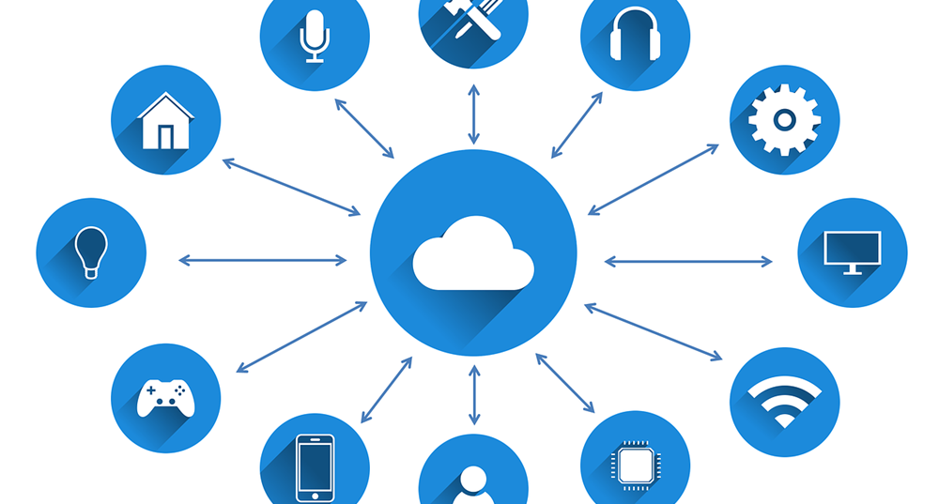
Internet of Things
Background
Collecting information from lots of devices is cool - but it is just telematics.

Slide 6
Internet of Things
Background
Merging perspectives between devices, systems, and humans to build a better understanding of the world around us.

Slide 7
Internet of Things
Background
But tying together insight with action - there lies the promise of IoT.

Slide 8
Internet of Things
Definition
“The network of physical objects that contain embedded technology to communicate and interact with their internal states or the external environment.”
Source: Gartner

Slide 9
Internet of Things
What is it?
Unique objects connected to Internet
Devices, not people
Bi-directional communication
Large, complex data flows
New types of insight

Slide 10
Internet of Things
Why is it important?
There are 13.8 Billion IoT devices in the world today, outnumbering the global population almost by twice
The worldwide government Internet of Things (IoT) endpoint electronics and communications market will total $21.3 billion in 2022, according to Gartner, Inc. This is a 22% increase from a forecasted total of $17.5 billion in 2021.
Leading Industry examples :
utilities, insurance, agriculture, factory, automobiles, transport, consumer, etc

Slide 11
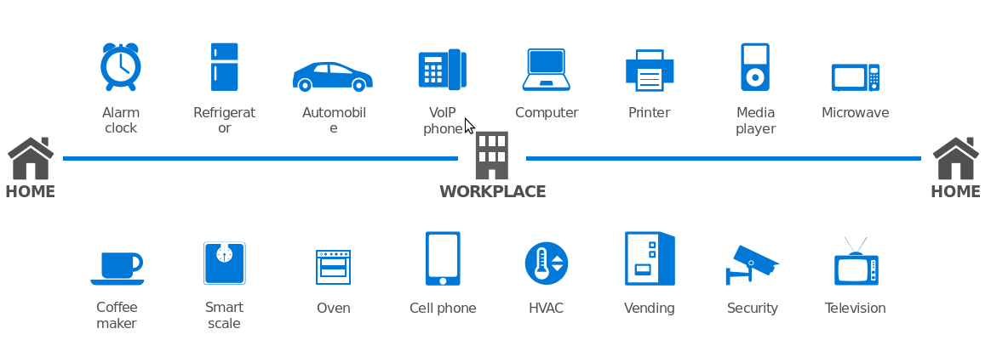
Internet of Things
The End to End Flow

Slide 12
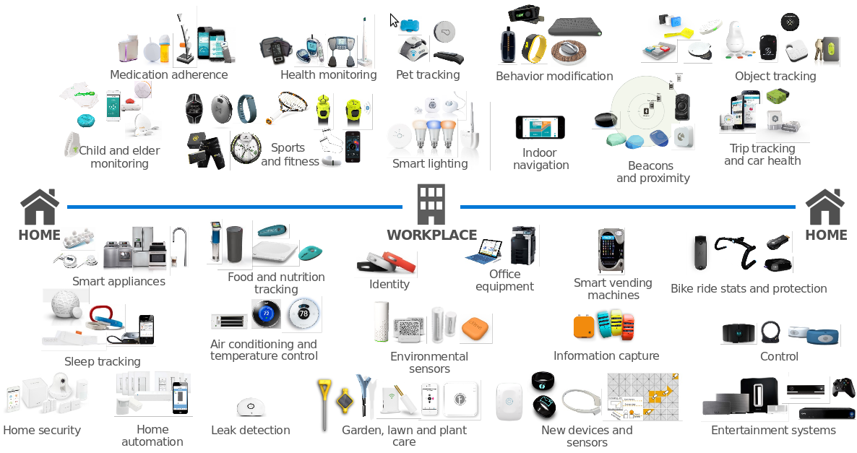
Internet of Things
The End to End Flow

Slide 13
Architectural Overview

Slide 14





Internet of Things
POV: IoT is at an Inflection Point

Slide 15





Internet of Things
General Technical Requirements

Slide 16





Internet of Things
Challenges

Slide 17

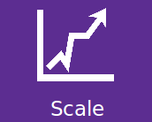
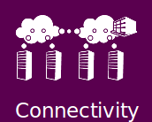







Internet of Things
First Principle

Slide 18
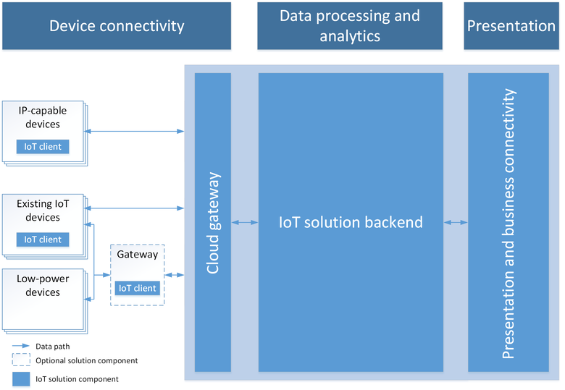
Internet of Things
Reference Architecture

Slide 19
Internet of Things
Architecture: Summary
Architecture is at the center of IoT
● IoT is Advanced “Modern” Architecture
● IoT Projects are Complex - Teamwork is necessary
● These projects are mission critical and difficult
● We can’t learn everything - but we need breadth
● Don’t be afraid - get started and learn

Slide 20
Thank You

